Slide 1
Capstone Presentation
HEALTH CARE
Jiya Jacob
PGP DSBA – July B
25-06-2022

Slide 2
Business Problem Understanding
Health care is a very important aspect of an individual’s life
It is also an important domain in the market.
Money plays a key role here
Tough situation for those who are not covered under insurance
The companies also want to reduce their risk

Slide 3
Objective:
The objective of this project is to build models using the data that provides the optimum insurance cost of an individual. The health and habit related parameters are used to estimate the cost of the insurance.
We will build models and looks at the performance metrices such as R squared, Adj R squared, RMSE and MAPE.
Lower the MAPE and RMSE value, better the model. Higher the R squared and Adj R squared value, better the model.
The model which follows the above two rules turn out to be the best model and by finalising the best model, we can identify important factors that are influencing the insurance cost.

Slide 4
Constraints faced:
The columns in the given data set ,”Year-last-admitted” had 47.5% missing values which cannot be imputed with any kind of methods because we cannot use the mean or median or KNN imputer. Due to these constraints we dropped the column.
There are outliers present in the columns such as ‘BMI’, ’ regular_checkup_lasy_year’,’ daily_avg_steps’. There wasn’t any support system to consult and find out whether these outliers are genuine or not.
We are working with just 25000 records which is quite small.
Scope:
Descriptive, inferential and predictive analytics is in scope of this project.

Slide 5
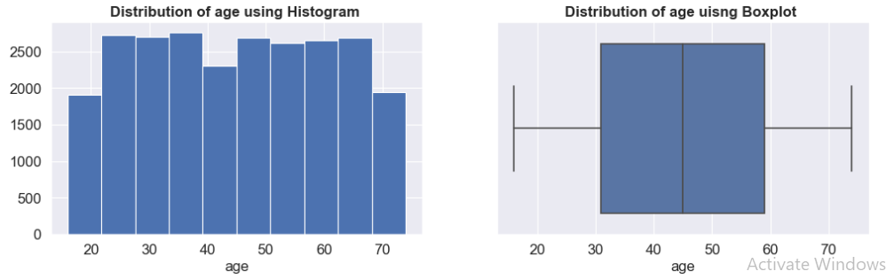
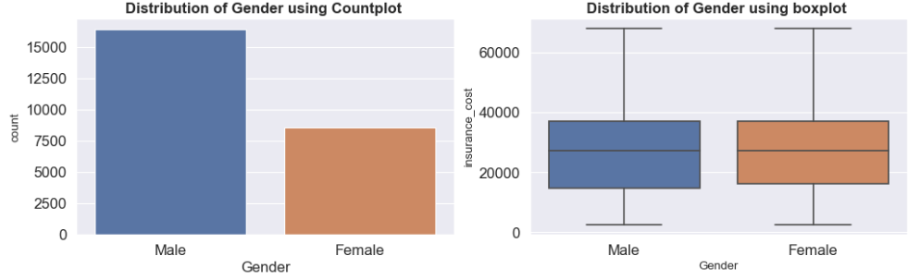
EXPLORATORY DATA ANALYSIS
66% of the customers are male. 34% customers are female.
30,000 is the median insurance cost for both male and female.
45 is the median age of the customers
74 is highest age of the customer.
16 is the minimum age of the customer.

Slide 6
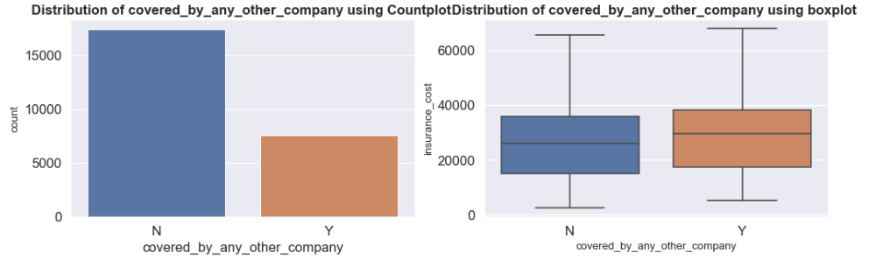
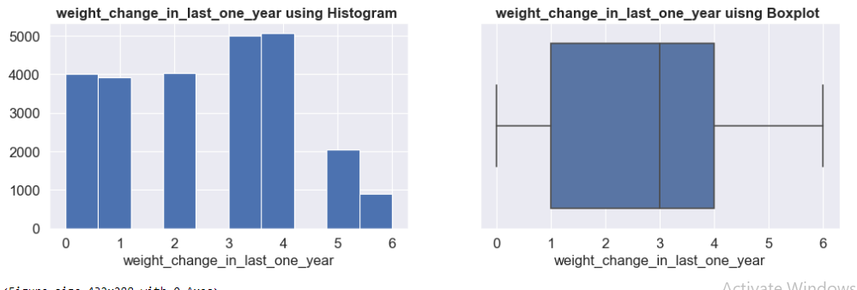
30% of the customers have their health insurance covered by other company.
The median of the insurance cost of those customers covered by other company is higher than the others whose insurance cost is not covered.
20% of the customers had their weight change 4 times last year
3.6% of the customers had their weight change 6 times last year

Slide 7
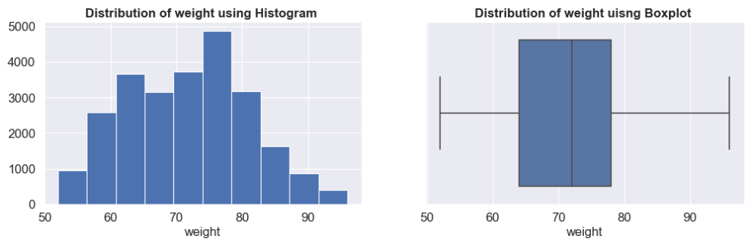
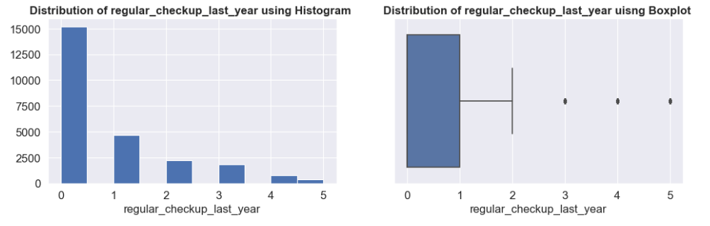
72 is the median weight of the customers.
96 is the maximum weight of the customers.
52 is the minimum weight of the customers.
61% of the customers didn’t have any regular check-up last year.
1% of the customers did 5 times regular check up last year.

Slide 8
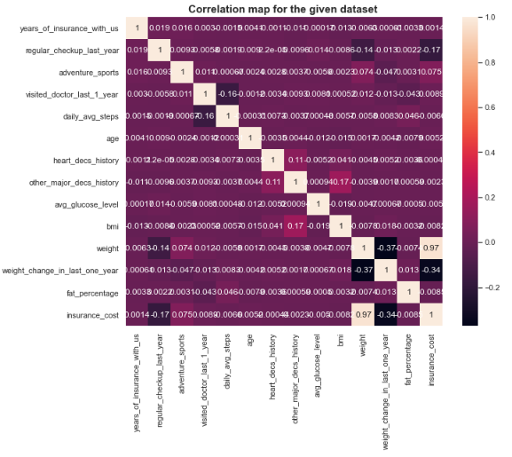
From the heat map we see that,
Insurance cost and regular check up to doctor last year shares a negative correlation.
Similarly weight change in last one year and weight has a negative correlation with insurance cost.
There is a high positive correlation between bmi and other major disease history.
A high positive relation is observed between heart disease history and other major disease history.

Slide 9
OTHER INFERRENCES
The customers who rarely consume alcohol has the majority with 55%.
37% of the customers have never smoked.
41% of the customers are students and 40% of the customers are running their own business.
The smoking status , manner of alcohol consumption, manner of exercise and occupation does not influence their insurance cost.

Slide 10
Modelling Approach Used & Why
We have built three different categories of models.
Linear models
Linear regression
Lasso regression
Ridge regression
Non- Linear models
Decision trees(CART)
Random Forest
ANN(Artificial Neural Network)
Ensemble Models
Ada boosting
Gradient boosting
Bagging
Performance metrices :
a. R squared
b. Adj R squared
c. RMSE
d. MAPE

Slide 11
Steps involved
Data import and pre-processing
Exploratory data analysis and visualization
Splitting the data into train and test sets
Scaling and encoding the data
Tuning the models and deciding the best model by comparing the performance metrices of the models before and after tuning.
Fit the data onto the desired models and derive results
Decide the best model and give both qualitative and quantitative recommendations.

Slide 12
Before tuning
 | Train Data |  |  | Test Data
 | R² | RMSE | MAPE | R² | RMSE | MAPE
Linear Regression | 94.468 | 3379.429 | 0.1535 | 94.49 | 3336.76 | 0.1509
Random Forest | 99.31 | 1193.25 | 0.0460 | 95.10 | 3145.35 | 0.1239
CART | 1.00 | 00.00 | 00.00 | 90.63 | 4349.65 | 0.1651
After Tuning
 | Train Data |  |  | Test Data
 | R² | RMSE | MAPE | R² | RMSE | MAPE
Lasso Regression | 94.468 | 3379.434 | 0.1535 | 94.49 | 3336.64 | 0.1509
Ridge Regression | 94.468 | 3379.429 | 0.1535 | 94.49 | 3336.75 | 0.1509
Random Forest | 92.78 | 3858.88 | 0.1779 | 91.92 | 4038.80 | 0.1239
CART | 95.63 | 3001.51 | 0.1186 | 95.21 | 3109.03 | 0.1220
From the above tuning process, we can conclude that regularization done on linear regression has no impact on its model performance.
It is observed that the model performance of Random Forest is better before tuning.
The model performance of CART has improved after model tuning

Slide 13
Train data
 | R² | Adj R² | RMSE | MAPE
Linear regression | 94.468 | 96.12 | 3379.429 | 0.1535
Random Forest (Before grid search) | 99.31 | 99.51 | 1193.25 | 0.046
CART (after grid search) | 95.63 | 95.42 | 3001.51 | 0.118
ANN | 95.52 | 96.81 | 3038.31 | 0.122
Gradient boosting | 95.57 | 96.89 | 3023.80 | 0.123
ADA Boosting | 94.90 | 96.43 | 3242.41 | 0.1408
Bagging on CART | 99.10 | 99.37 | 1358.78 | 0.049
Bagging on RF | 98.31 | 98.81 | 1867.18 | 0.073
 | R² | Adj R² | RMSE | MAPE
Linear regression | 94.49 | 98.34 | 336.76 | 0.1509
Random Forest (Before grid search) | 95.10 | 98.52 | 3145.35 | 0.1239
CART (after grid search) | 95.21 | 95.20 | 3109.03 | 0.1220
ANN | 95.15 | 98.54 | 3127.68 | 0.1284
Gradient boosting | 95.42 | 98.62 | 3039.99 | 0.1245
ADA Boosting | 94.79 | 98.43 | 3243.96 | 0.1411
Bagging on CART | 94.75 | 98.42 | 3254.66 | 0.1277
Bagging on RF | 95.30 | 98.58 | 3080.46 | 0.1277
Test data

Slide 14
From the above metrices, we can see that the model performance of all the models are good
Linear regression has the lowest model score and Gradient Boosting has the highest model score.
But out of all the models we can conclude that Gradient boosting is the best model with the model score of 95.42%.
Gradient Boosting is the model with highest accuracy and lowest MAPE value.
The MAPE score of Gradient Boosting is 12.45 which means that the predicted values is 12.45% deviated from the actual values.
By doing the feature importance in Gradient Boosting we have found out that mainly four health parameters play the crucial role in deciding the insurance cost of the customers. They are:
regular_checkup_last_year’,
'weight’,
'weight_change_in_last_one_year’
'covered_by_any_other_company_Y’.

Slide 15
Recommendations
People with high frequency of regular_checkup_last_year can be given some insurance bonuses as a token of reward for being health conscious, while those with less frequency should be charged more insurance cost.
People whose health insurance is covered by another company can be attracted to this company with attractive offers, bonuses and life-long trustworthy policies.
People who had greater change in their weight in last year can be offered free medical tests and treatment at reduced rates, in order to retain the customers.
People who are dealing with over- weight or heavy weight issues are easily prone to more diseases. So, such people can be spotted out and they can be encouraged to do regular follow-ups and medical tests for which discounts or allowances can be given.
The people who are into adventure sport, who are regular smokers and drinkers, who have visited the doctor many times last year can be treated as target customers and offered medical claims at attractive rates.

Slide 16
THANK YOU

